Slide 1

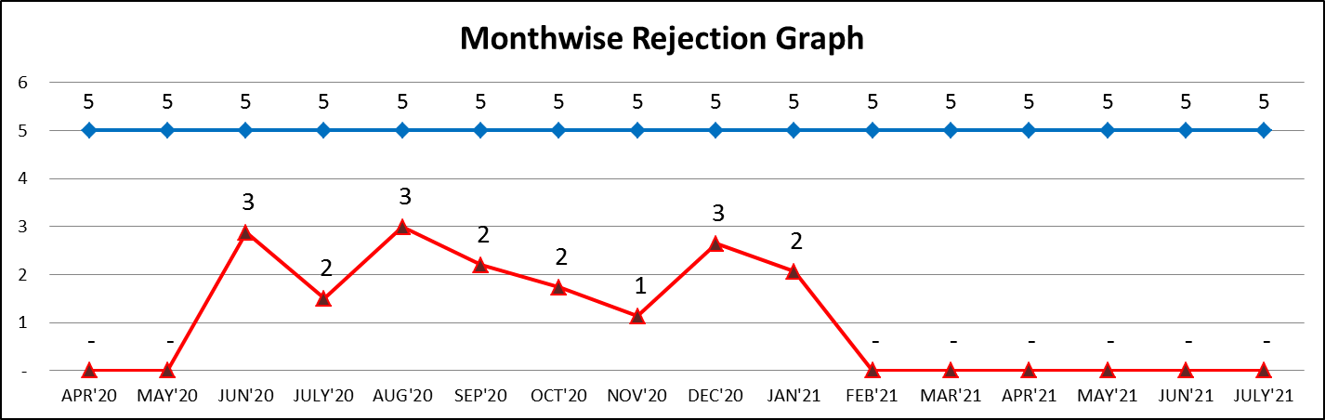
IQC
Sr. No | Date/Month | KPI Head | Part Name | Issues | Analysis | Action Plan | Tgt. Date | Responability | Status (Done Or Not Done)
1 | 01/01/2021 | LAR | WIRE HARNESS 15/25 LTR AMICA | MALE & FEMALE CONNECTION LOOSE | AT IQC END | Lot Hold &1 00 % Segregation & Inspection | 03/01/2021 | GENERAL ELECTRICALE DELHI | DONE BY STORE
2 | 01/01/2021 | LAR | ECN WIRE HARNESS 15/25 LTR | INDICATOR NOT GLOW & SHOLDERING IMPROPER | AT IQC END | Lot Hold &1 00 % Segregation & Inspection | 03/01/2021 | GENERAL ELECTRICALE DELHI | DONE BY TESTING
3 | 03/01/2021 | LAR | WIRE HARNESS 15/25 LTR AMICA | MALE & FEMALE CONNECTOR LOOSE | AT IQC END | Lot reject & Send Back to supplier | 05/01/2021 | GENERAL ELECTRICALE DELHI | DONE
4 | 03/01/2021 | LAR | WIRE HARNESS 10 LTR AMICA | MALE & FEMALE CONNECTOR LOOSE | AT IQC END | Lot reject & Send Back to supplier | 05/01/2021 | GENERAL ELECTRICALE DELHI | DONE
5 | 06/01/2021 | LAR | WIRE HARNESS 10 LTR AMICA | MALE & FEMALE CONNECTOR LOOSE | AT IQC END | Lot Hold &1 00 % Segregation & Inspection | 07/01/2021 | GENERAL ELECTRICALE DELHI | DONE BY STORE
6 | 06/01/2021 | LAR | INDICATOR LENS RED & GREEN | GREEN INDICATOR CRACK | AT IQC END | Lot reject & Send Back to supplier | 07/01/2021 | GENERAL ELECTRICALE DELHI | DONE

Slide 2
IQC
Sr. No | Date/Month | KPI Head | Part Name | Issues | Analysis | Action Plan | Tgt. Date | Responability | Status (Done Or Not Done)
6 | 06/01/2021 | LAR | INDICATOR LENS RED & GREEN | GREEN INDICATOR CRACK | AT IQC END | Lot reject & Send Back to supplier | 07/01/2021 | GENERAL ELECTRICALE DELHI | DONE
7 | 06/01/2021 | LAR | ECN POWER CORD (1.2M) | LENGTH OVERSIZE AND GROOMET LENGTH SHORT | AT IQC END | Lot reject & Send Back to supplier | 08/01/2021 | KREATIVE TEACHNOLOGY | DONE
8 | 08/01/2021 | LAR | PC PLATE STICKER 10 LTR AMICA | FITMENT NOT PROPER | AT IQC END | Lot Hold &1 00 % Segregation & Inspection | 10/01/2021 | IMPACT STICKERS | DONE BY PRODUCTION
9 | 08/01/2021 | LAR | LEAD GROMMET | FLASHES | AT IQC END | Lot Hold &1 00 % Segregation & Inspection | 10/01/2021 | K.R RUBBER | DONE BY PRODUCTION
10 | 08/01/2021 | LAR | INDICATOR LENS RED & GREEN | INDICATOR CRACK | AT IQC END | Lot reject & Send Back to supplier | 11/01/2021 | SENSATION SYSTEM | DONE
11 | 08/01/2021 | LAR | INDICATOR LENS RED & GREEN | INDICATOR CRACK | AT IQC END | Lot reject & Send Back to supplier | 11/01/2021 | SENSATION SYSTEM | DONE
12 | 21/01/2021 | LAR | MS TANK 25 LTR AMICA | IP& OP PIPE BEND | AT IQC END | Lot Hold &1 00 % Segregation & Inspection | 23/01/2021 | ONKAR D-255 | DONE
13 | 21/01/2021 | LAR | MS TANK 15 LTR AMICA | IP& OP PIPE BEND | AT IQC END | Lot Hold &1 00 % Segregation & Inspection | 23/01/2021 | ONKAR D-255 | DONE
14 | 23/01/2021 | LAR | MS TANK 25 LTR AMICA | IP& OP PIPE BEND | AT IQC END | Lot Hold &1 00 % Segregation & Inspection | 25/01/2021 | ONKAR D-255 | DONE
15 | 25/01/2021 | LAR | SILICON SLEEVE YELLOW & BLUE 103 MM AMICA | COLOR VARIATION | AT IQC END | Lot Hold &1 00 % Segregation & Inspection | 27/01/2021 | K.R RUBBER | DONE BY PRODUCTION
16 | 27/01/2021 | LAR | POWER CORD (1.2 M ) AMICA | COLD RESISTANCE HIGH | AT IQC END | Lot Hold &1 00 % Segregation & Inspection | 30/01/2021 | KREATIVE TEACHNOLOGY | DONE BY PRODUCTION

Slide 3
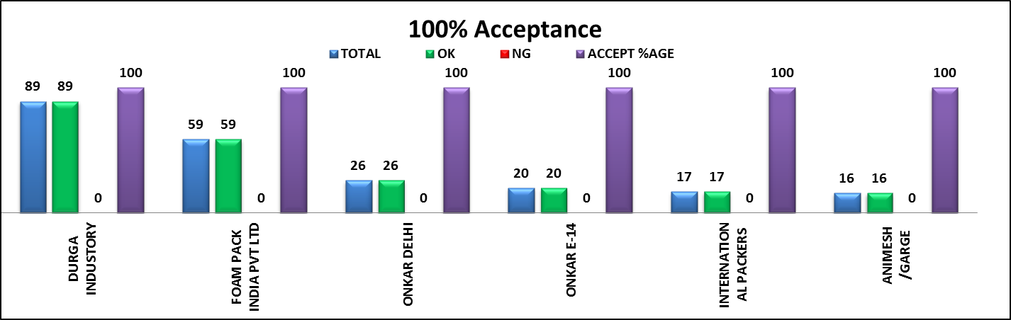
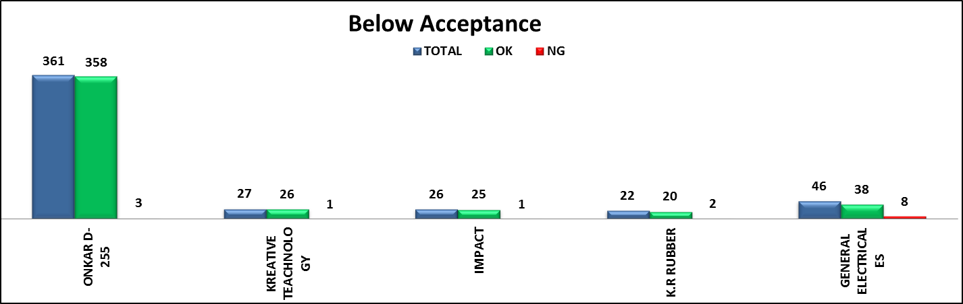
IQC

Slide 4
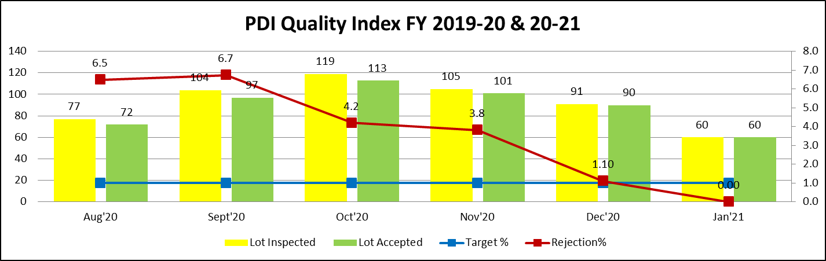
PDI
S.No | Date | Issue | Root Cause | Action Plan | Trg Date | Resp. | Status
1 | Oct'19 | Body gap | Uneven gap in already in part | All the uneven gaps with in 0 to 0.8mm segregated and beyond the limits pieces segregated and scrap | 09.10.19 | Quality | Done
2 | Oct'19 | Inlet/outlet pipe paint | black primer not dried during the processing & during handling, paint pill off | One extra person deputed on the fine for 100% verification as well as repainting for the faulty one | 15.10.19 | Prod. | Done
3 | Nov'19 | Puf puncture b/w top and bottom | New Puf die not properly closed after Puf pouring due to faulty lock mechanism | Lock mechanism corrected | 07.11.19 | Tooling Team | Done
4 | Nov'19 | Top & Bottom cover colour variation | Different setting in molding machine for tops & bottom cover in the same lot & no proper information given to line by molding team | molding team segregated all the stocked item also proper information & on the cover, like lot no. & operator name | 08.11.19 | Prod. | Done
5 | Dec'19 | Body paint peel off in bidding area | Improper febrication setting during bidding at supplier end | Communicated the paint peel off issue at supplier end & Next supply will be OK | 14.12.19 | OEGPL D-255 | Done
6 | Dec'19 | Rating Lebel pasting wrong | New sticker pasting person depted on line | Proper training imparted to the new person | 26.12.19 | Prod. | Done
7 | Dec'19 | Harness Loose | Service cover assembly operator not properly verify connection & close the service cover | One new check added for wire harness connection verifiation & past OK sticker after verification | 28.12.19 | Quality | Done

Slide 5
PDI
Sr.No | Date | Issue | Root Cause | Action Plan | Trg Date | Resp. | Status
8 | Jan'20 | puf found on inlet /outlet pipe | Gap in b/w tank and plastic body causes puf puncture from the same area | Glasswool provided in b/w the gap | 03.01.20 | Prod. | Done
9 | Jan'20 | Improper cleaning | New person on cleaning without training | Proper training imparted to the new person | 02.01.2020 | Quality | Done
10 | Jan'20 | Scratches mark on body | Rough handling on the assembly line | All the scratches pieces segregated in lot | 03.01.2020 | Quality | Done
11 | Jan'20 | 5 star rating (BEE sticker) pasted wrong | New person deputed on sticker pasting pasting without proper training | Proper training imparted to the new person | 21.01.20 | Quality | Done
12 | Jun'20 | Improper red oxide on Inlet/outlet pipe | Unskilled person | Provided proper training | 09.06.20 | Quality | Done
13 | Jun'20 | Flexible hose pipe missing | No check point at final stage | Accessories verification check point added with visual inspection sheet | 25.06.20 | Quality | Done
14 | July'20 | Wong sticker positioning & box teared (2) | No fixture provided for sticker positioning (pasting byhand) & Location not define for proper for box | Fixture provided for sticker positioning & location define for packing box, as per model | 14.07.20 | Prod. | Done
15 | July'20 | Puf puncture Cap fittment Scratches PCB wire routing | Puf die not properly closed after puf pouring Rough handling on the assembly line Puf pouring hole, improper cutting through hole saw Unskilled person not proper handling PCB wire | Puf die lock mechanism corrected Proper training provided to all the concern person also given hand gloves to all persons involved in assembly line Puf pouring hole saw changed weekly Given proper training to concern person on assembly | 31.07.20 | Prod. | Done
16 | Aug'20 | Puf cap loose | Puf poring hole size over | Hole cutter changed and given as per puf cap sampling | 05.08.20 | Prod. | Done
17 | Aug'20 | Improper cleaning (2) | PUF liquid impression on body due to not proper cleaned | PUF pouring head changed | 05.08.20 | Prod. | Done
18 | Aug'20 | Wong PDP sticker pasted | New sticker pasting person deputed on line | Given proper training to new person | 10.08.20 | Quality | Done
19 | Aug'20 | Sticker not in position on product | New sticker pasting person depted on line | Given proper training to new person | 18.08.20 | Quality | Done
20 | Sept'20 | Knob wrong fitted | Lack of knowledge | Given proper training to new person | 05.09.20 | Quality | Done
21 | Sept'20 | Clamp Issue (2) | Clamp issue came from due to body fitment | One person deputed to check clamp fitment | 25.09.20 | Quality | Done
22 | Oct'20 | 7" cut out instead of 11" | During model change both cutout mix at line | Seprate location provided for cutout & given proper training | 10.10.20 | Prod. | Done
23 | Oct'20 | Scratches & cleaning | PUF Die is not proper cleaned New person deputed on cleaning without proper training | Die clean every 2 hrs. Proper training imparted | 16.10.20 | Quality | Done
24 | Oct'20 | PDP shrinkage on packing box | Packing box in wet condition | Segregation & dry by fan air | 19.10.20 | Prod. | Done
25 | Oct'20 | Scratches & cleaning | EPE foam thermocol life is over | Change EPE foam thermocol within every 3 months | 29.10.20 | Prod. | Done
26 | Oct'20 | Top cover scratches | EPE foam thermocol life is over | Change EPE foam thermocol within every 3 months | 29.10.20 | Prod. | Done
27 | Nov'20 | Scratches & Clamp Issue | During welding clamp out & fixture play Rough surface on cleaning table | Given new fixture EPE foam pasted on cleaning table | 05.11.20 | Prod. | Done
28 | Nov'20 | Coating break near neck ring | Primer coating fixture wear out | New fixture provided | 06.11.20 | Prod. | Done
29 | Nov'20 | Cut out not cut on specific range (2) | 1°C variation in bath testing and water not circulate properly | Motor (Pump) changed & monitoring | 11.11.20 | Prod. | Done
30 | Dec'20 | PDP sticker wrong pasted | Separate Location not define at line | Separate location define to avoid to mix PDP sticker & Bin provided in store to kept separately PDP sticker | 21.12.20 | Prod. | Done

Slide 6
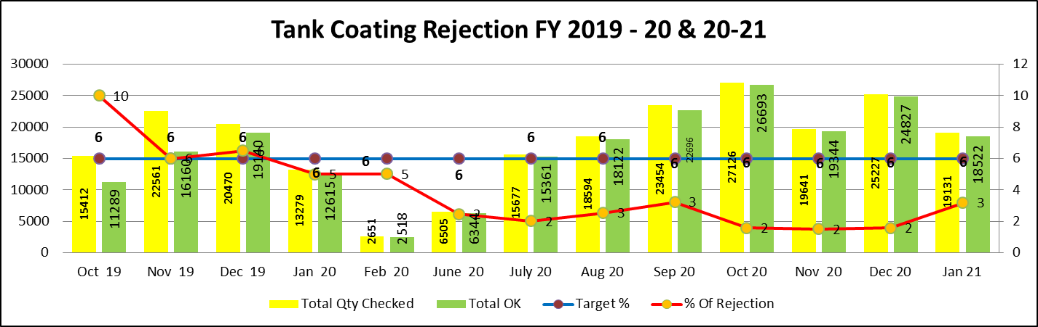
Process Rejection Trend Tank Coating
Sr.No | Month | Issue | Root Cause | Action Plan | Trg Date | Resp. | Status
1 | Oct-19 | Pin Hole | 1- Out of 6 Robotics gun 3 gun charging was not up to mark 2- Oven temperature | 1- Gun replaced 2- TTR done & observed OK | 12.10.19 | Prod. | Done

Slide 7
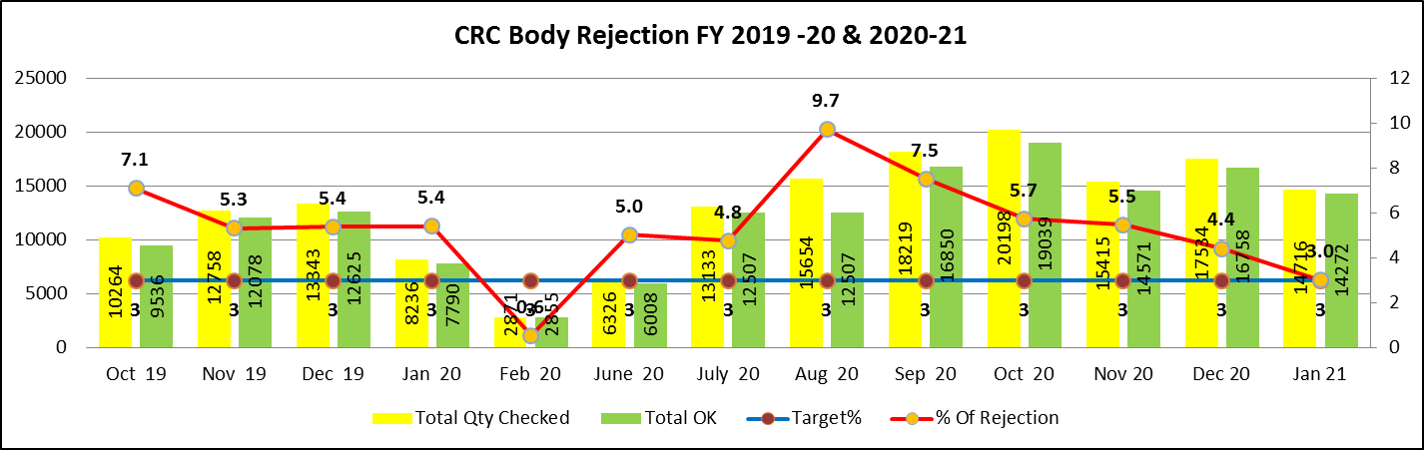
CRC Body Rejection
Sr.No | Month | Issue | Root Cause | Action Plan | Trg Date | Resp. | Status
1 | Oct 19 | Body Dent | Handling issue | feedback given to improve handling | 05.11.19 | OEGPL D-255 | Close
2 | Nov 19 | Body Dent | Handling issue | feedback given to improve handling | 07.12.19 | OEGPL D-255 | Close
3 | Dec 19 | Body Dent | Handling issue | feedback given to improve handling | 07.01.20 | OEGPL D-255 | Close
4 | Jan 20 | Body Dent | Handling issue | feedback given to improve handling | 06.02.20 | OEGPL D-255 | Close
6 | June 20 | Body Dent | Handling issue | feedback given to improve handling | 07.07.20 | OEGPL D-255 | Close
7 | July 20 | Body Dent | Handling issue | feedback given to improve handling | 05.08.20 | OEGPL D-255 | Close
8 | Aug 20 | Body Dent | Handling issue | feedback given to improve handling | 06.09.20 | OEGPL D-255 | Close
9 | Sep 20 | Body Dent | Handling issue | Decide in MRM to fabrication of CRC body in-house | 05.10.20 | OEGPL D-255 | Close
10 | Oct 20 | Body Dent | Handling issue | feedback given to improve handling | 08.11.20 | OEGPL D-255 | Close
11 | Nov 20 | Body Dent | Handling issue | feedback given to improve handling | 07.12.20 | OEGPL D-255 | Close
12 | Dec 20 | Body Dent | Handling issue | feedback given to improve handling | 05.01.21 | OEGPL D-255 | Close

Slide 8
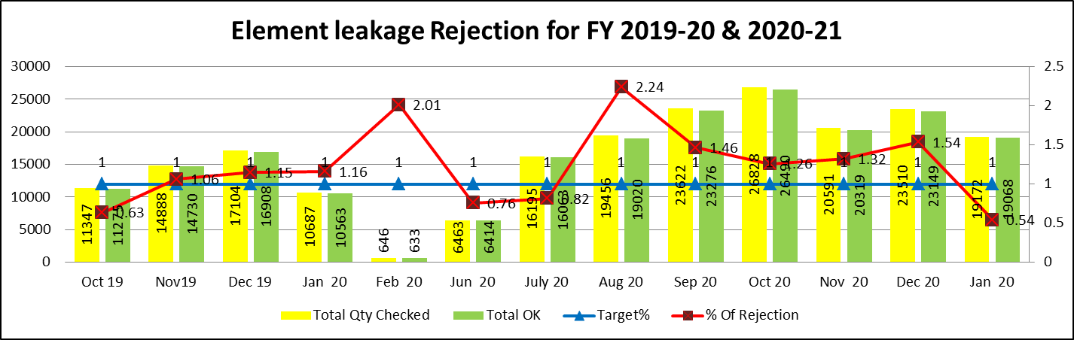
Process Rejection Trend Element Leakage
Sr.No | Month | Issue | Root Cause | Action Plan | Trg Date | Resp. | Status
1 | Nov 19 | Element Leakage | Less Heating temperature & time to dry Silicon compound | Given temp. & time as per requirement & Follow WI | 03.12.19 | Durga D-38 | Done
2 | Dec 19 | Element Leakage | RTV Compound not pasted properly | Given training to operator for use silicon | 07.01.20 | Durga D-38 | Done
3 | Jan 20 | Element Leakage | Jig & fixture not use during brazing (Fixture ware out) | New fixture provided for brazing | 09.02.20 | Durga D-38 | Done
4 | Feb 20 | Element Leakage | Leakage check on 6 bar not as per required specification 8 bar | given training to leakage check on 8 bar | 05.03.20 | Durga D-38 | Done
5 | Aug 20 | Element Leakage | 100% leakage testing not done at supplier end | Green color marking after leakage testing at supplier end | 11.09.20 | Durga D-38 | Done
6 | Sep 20 | Element Leakage | Supplier leakage testing machine breakdown & Spare part not available | On deviation | 05.10.20 | Durga D-38 | Done
7 | Oct 20 | Element Leakage | Machine under capacity | New setup to be purchased | 04.11.20 | Durga D-38 | Done
8 | Nov 20 | Element Leakage | Element cup plate step height out of specification | Tool issue & 100% recheck at supplier end | 10.12.20 | Durga D-38 | Done
9 | Dec 20 | Element Leakage | Element cup plate step height out of specification | Tool rectify / New leakage machine installed & Validation lot pending | 03.01.21 | Durga D-38 | Done

Slide 9
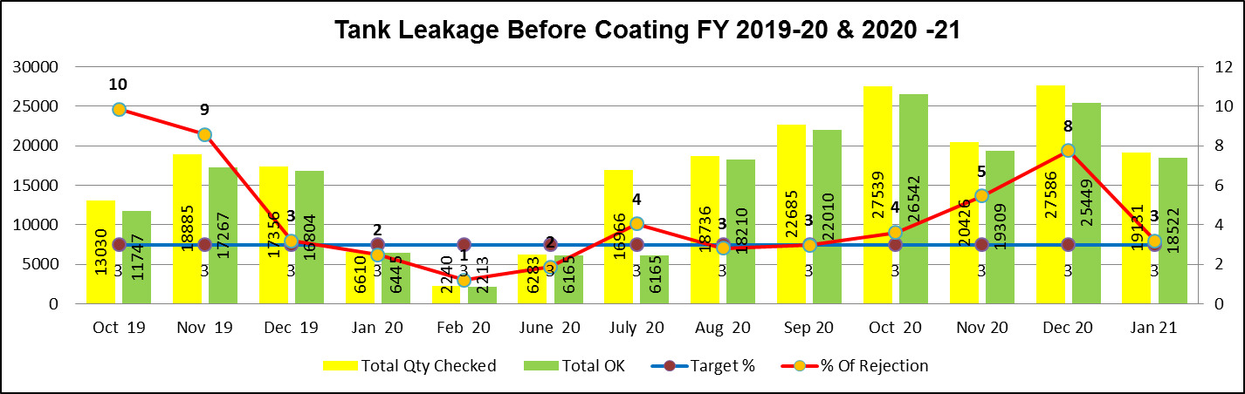
Tank Leakage before Coating
Sr.No | Month | Issue | Root Cause | Action Plan | Trg Date | Resp. | Status
1 | Oct 19 | Tank Leakage | Without leakage material dispatch | Inform to supplier and rejection data share | 05.11.19 | OEGPL D-255 | Done
2 | Nov 19 | Tank Leakage | Leakage test done on 5 bar | Leakage test done as per requirement (8 Bar) | 09.12.19 | OEGPL D-255 | Done
3 | July 20 | Tank Leakage | Supplier machine breakdown | New Machine setup install | 05.08.20 | OEGPL D-255 | Done
4 | Oct 20 | Tank Leakage | Sol. Qube leakage testing fixture non availability | Leakage testing fixture repaired | 11.11.20 | OEGPL D-255 | Done
5 | Nov 20 | Tank Leakage | Supplier machine breakdown | On deviation/ 100% check our end | 03.12.20 | OEGPL D-255 | Done
6 | Dec 20 | Tank Leakage | 1. Supplier machine breakdown 2. Spare part not available as per requirement | machine will be repaired | 05.01.21 | OEGPL D-255 | Done

Slide 10
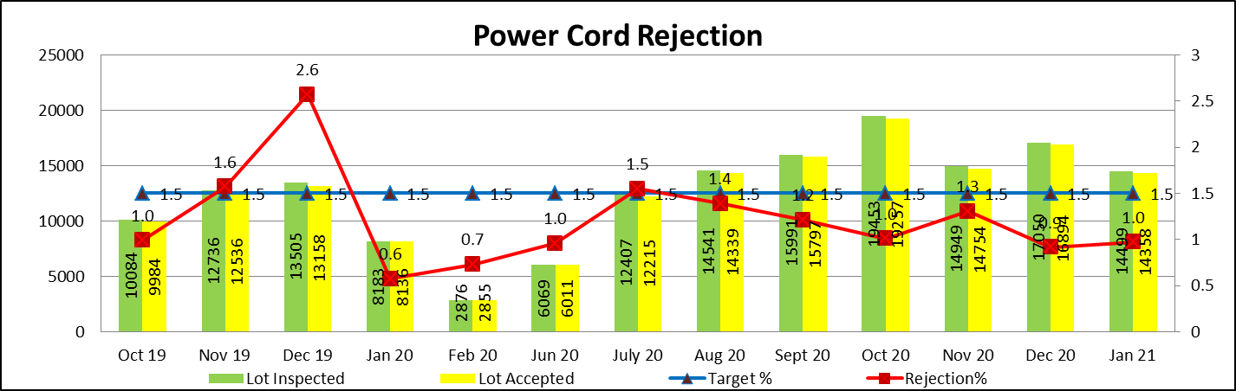
Power Cord Rejection (Amica) FY 2019-20 & 2020-21
Sr.No | Month | Issue | Root Cause | Action Plan | Trg Date | Resp. | Status
1 | Dec-19 | Power Cord pin dent | Transport & Handling dent | Power cord segregated & return back to supplier. Handling issue improved at supplier end | 09.01.20 | Vendor | Done

Slide 11
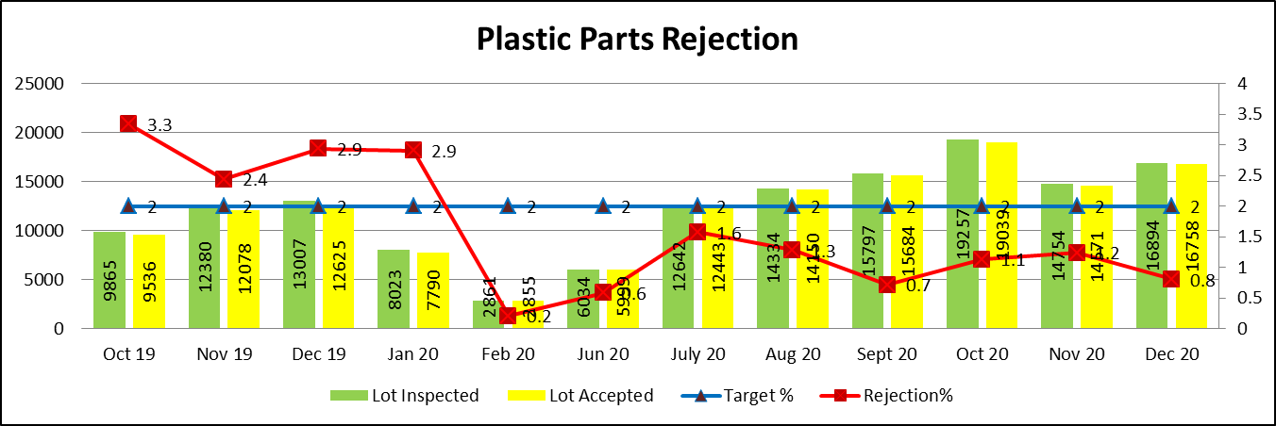
Plastic Parts Rejection (Amica) FY 2019-20 & 2020-21
Sr.No | Month | Issue | Root Cause | Action Plan | Trg Date | Resp. | Status
1 | Oct-19 | Scratches | Wrong Handling | Proper material packed in poly bag & box | 07.11.19 | Prod. | Done
2 | Nov-19 | Shrinkage | Parameter not maintain (temp. issue) | Parameter to be maintain & first part check by concern person | 09.12.19 | Prod. | Done
3 | Dec-19 | Color mismatch & Broken | Material not as per requirement | Material send back to supplier & First lot trail then lot except | 05.01.20 | Prod. | Done
4 | Jan-20 | Water marks & Scratches | Mold issue | Mold polishing | 07.02.20 | Prod. | Done

Slide 12
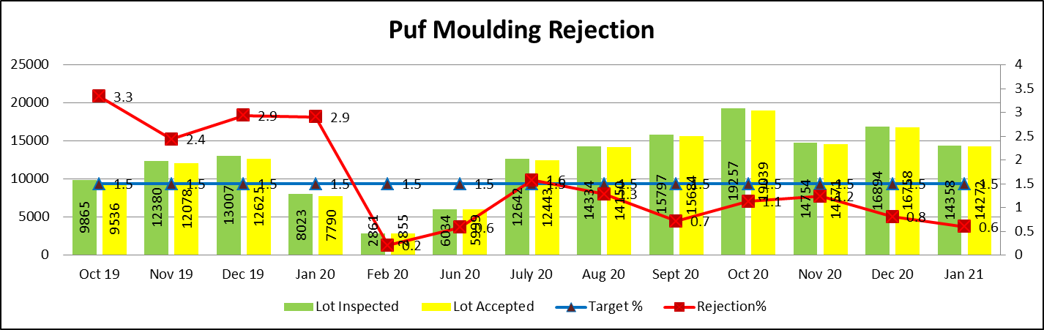
Puf molding Rejection (Amica) FY 2019-20 & 2020-21
Sr.No | Month | Issue | Root Cause | Action Plan | Trg Date | Resp. | Status
1 | July-20 | Puff Short | Less Pressure due to compressor not working | Compressor repaired | 07.08.20 | Maint. | Done
2 | Oct-20 | Puff Short | Chemical Issue | Chemical send back to supplier | 08.11.20 | Purchase | Done

Slide 13
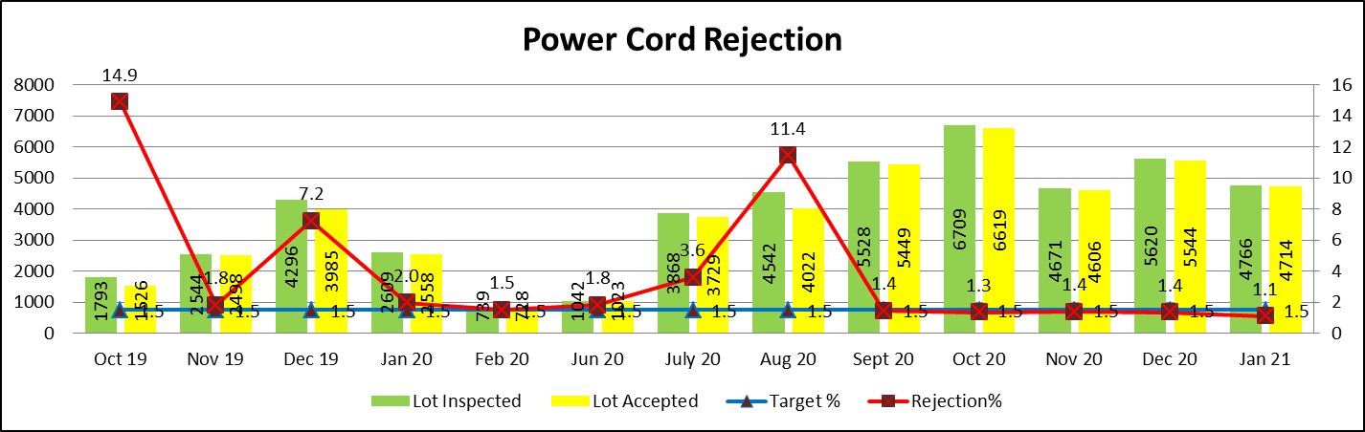
Power Cord Rejection (Qube) FY 2019-20 & 2020-21
Sr.No | Month | Issue | Root Cause | Action Plan | Trg Date | Resp. | Status
1 | Oct-19 | Power Cord pin dent | Transport & Handling dent | Power cord segregated & return back to supplier. Handling issue improved at supplier end | 09.11.19 | Bonex | Done
2 | Dec-19 | Thimble over size | Thimble mix during operation | Power cord segregated & return back to supplier. | 08.01.20 | Bonex | Done
3 | Jul-20 | Power Cord pin dent | Transport & Handling dent | Power cord segregated & return back to supplier. Handling issue improved at supplier end | 09.01.20 | Safecord | Done
4 | Aug-20 | Power Cord Break & Damage | Not cutting properly during cutting operation | Power cord segregated & return back to supplier. | 10.09.20 | Safecord | Done

Slide 14
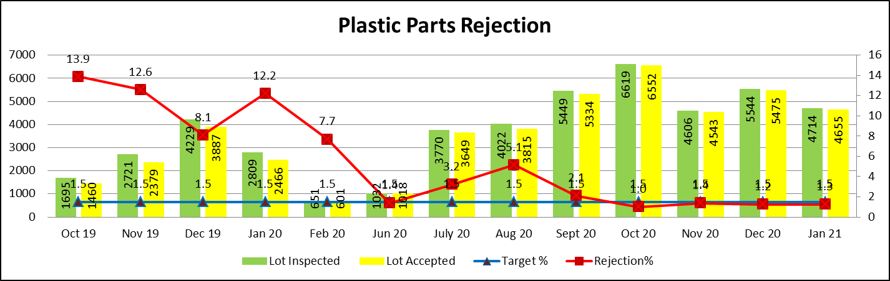
Plastic Parts Rejection (Qube) FY 2019-20 & 2020-21
Sr.No | Month | Issue | Root Cause | Action Plan | Trg Date | Resp. | Status
1 | Oct-19 | Shrinkage | Parameter not maintain (temp. issue) | Parameter to be maintain & first part check by concern person | 08.11.19 | Prod. | Done
2 | Nov-19 | Scratches | Wrong Handling | Proper material packed in polybag & box | 08.12.19 | Prod. | Done
3 | Dec-19 | Color mismatch | Material not as per requirement | Material send back to supplier | 05.01.20 | Prod. | Done
4 | Jan-20 | Water marks & Scratches (Top Cover) | Mould issue | Mould poolishing to avoid flow marks | 07.02.20 | Prod. | Done
5 | Feb-20 | Water marks & Scratches (Bottom Cover) | Mould issue | Mould poolishing to avoid flow marks | 07.02.20 | Prod. | Done
6 | Jul-20 | Color Variation (Top & Bottom Cover)` | Material Issue | On Deviation | 12.07.20 | Prod. | Done
7 | Aug-20 | Black Spot | Material Issue | Material send back to supplier | 11.09.20 | Prod. | Done

Slide 15
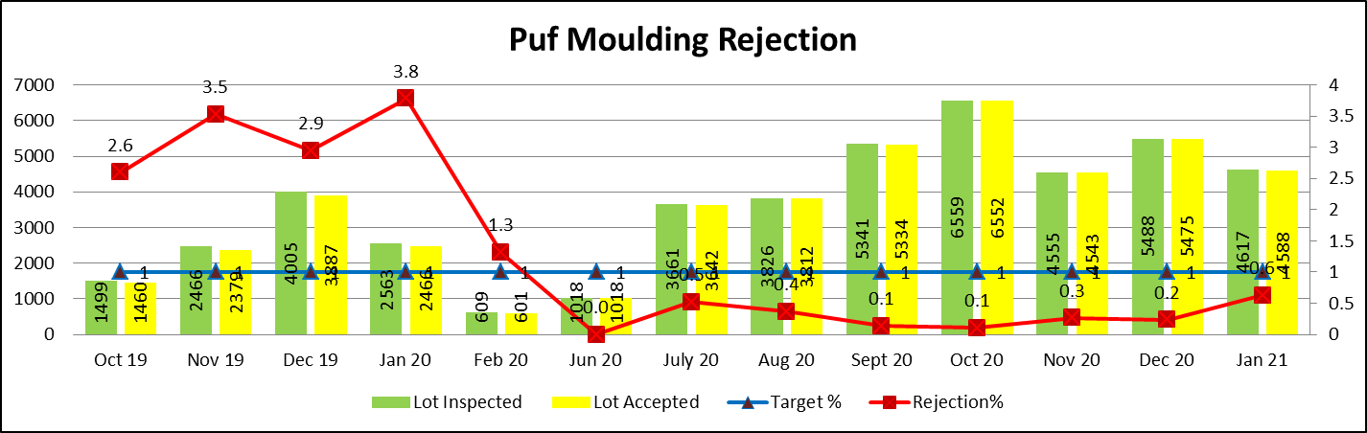
Puf molding Rejection (Qube) FY 2019-20 & 2020-21
S.No | Month | Issue | Root Cause | Action Plan | Trg Date | Resp. | Status
1 | Oct-19 | Puf Puncture (15 ltr) | Top & Bottom cover peorperly not lock | Mould Rectification | 09.11.19 | Tooling | Done
2 | Nov-19 | Puff Short | Chemical Issue | Chemical send back to supplier | 08.11.20 | Purchase | Done
3 | Dec-19 | Puf Puncture (25 ltr) | Top & Bottom cover peorperly not lock | Mould Rectification | 07.02.20 | Tooling | Done
4 | Jan-20 | Puff Short | Less Pressure due to compressure not working | Compressure repaired | 09.02.20 | Maint. | Done

Slide 16
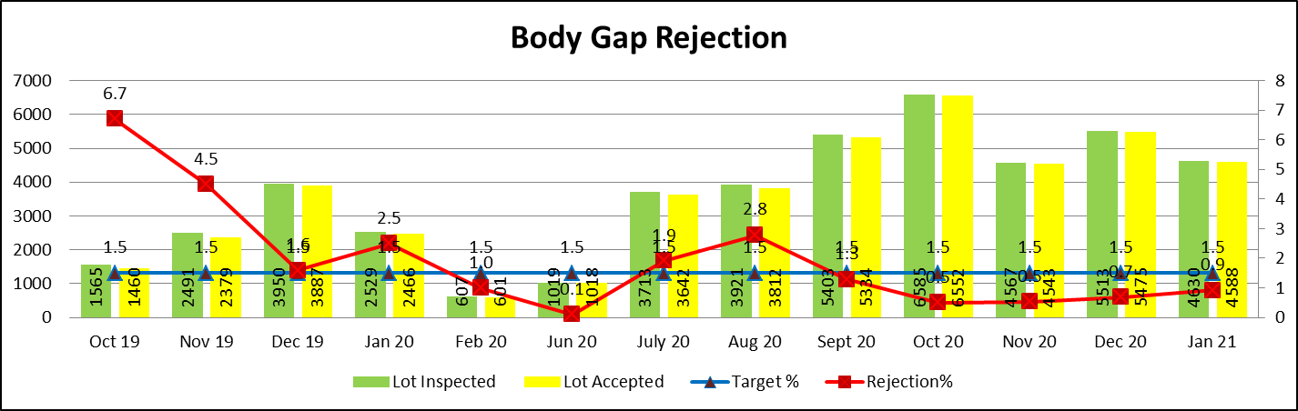
Body Rejection (Qube) FY 2019-20 & 2020-21
Sr.No | Month | Issue | Root Cause | Action Plan | Trg Date | Resp. | Status
1 | Oct-19 | Over Puf | IP ratio not maintain as per requirement | IP ratio to maintain as per WI | 10.11.19 | Prod. | Done
2 | Nov-19 | Lock fittment | Tooling Issue | Tool Rectification | 08.12.19 | Tooling | Done
3 | Jan-20 | Lock fittment | Tooling Issue | Tool Rectification | 03.01.20 | Tooling | Done
4 | Aug-20 | U Clamp Fittment | U clamp out during tank welding | Seggregated & return back to supplier. | 06.08.20 | Tooling | Done

